Slide 1


Slide 2
Date | Time | Topic | Resource person
8/3/2023 | 2.50pm- 4.10pm | Java script concepts | Jobin Thomas, Assistant Professor, CSE, Presidency University
11/3/2023 | 9am - 11.00 | Node JS and Type Script | Jerrin joe Francis, Assistant Professor, CSE, Presidency University
11/3/2023 | 1.30pm - 3.00pm | Angular JS | Pakruddin Basha, Assistant Professor, CSE, Presidency University
11/3/2023 | 3.00pm - 4.10pm | React JS | Dr. Jayanthi Kamalesan & Ms.Sweet Subhashree, Assistant Professors, CSE, Presidency University

Slide 3
Javascript

Slide 4
What is Javascript?
a lightweight programming language ("scripting language")
used to make web pages interactive
insert dynamic text into HTML (ex: user name)
react to events (ex: page load user click)
perform calculations on user's computer (ex: form validation)
JavaScript makes web pages more dynamic and user-friendly so that they respond to visitors' actions.
OR, to put it another way, JavaScript makes web pages interactive.

Slide 5
Linking to a JavaScript file: script
<script src="filename" type="text/javascript">
</script>
script tag should be placed in HTML page's head
script code is stored in a separate .js file
JS code can be placed directly in the HTML file's body or head (like CSS)

Slide 6
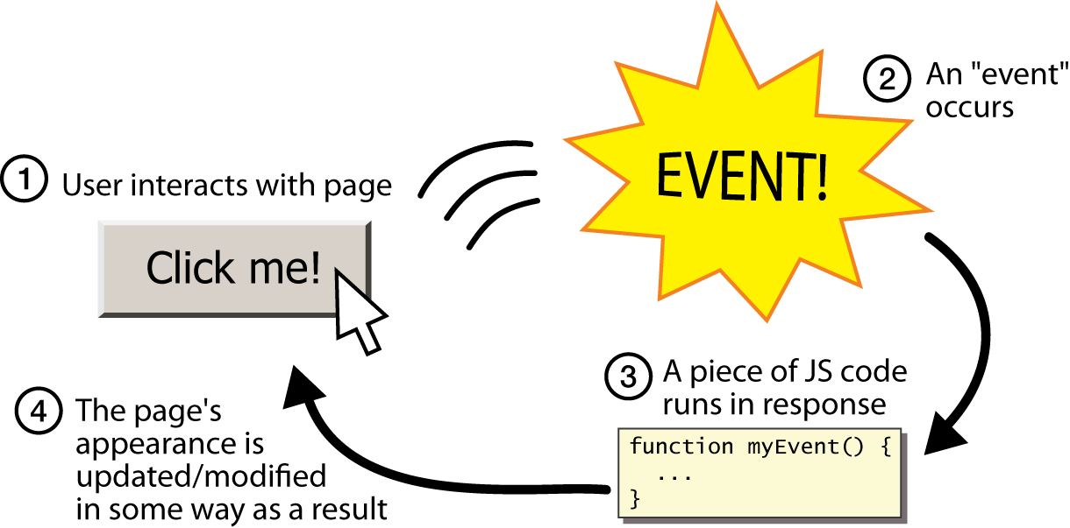
Event-driven programming

Slide 7
Event handlers
<element attributes onclick="function();">...
<button onclick="myFunction();">Click me!</button>

Slide 8

The HTML DOM (Document Object Model)
Tree of Objects

Slide 9
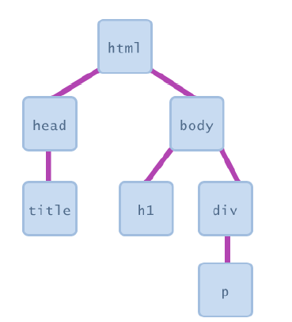
Document Object Model (DOM)
JavaScript can change all the HTML elements in the page
JavaScript can change all the HTML attributes in the page
JavaScript can change all the CSS styles in the page
JavaScript can remove existing HTML elements and attributes
JavaScript can add new HTML elements and attributes
JavaScript can react to all existing HTML events in the page
JavaScript can create new HTML events in the page

Slide 10
Accessing elements: document.getElementById
document.getElementById returns the DOM object for an element with a given id
can change the text inside most elements by setting the innerHTML property
can change the text in form controls by setting the value property

Slide 11
Accessing elements: document.getElementById
In the DOM, all HTML elements are defined as objects.
<body> <p id="demo"></p>
<script> document.getElementById("demo").innerHTML = "Hello World!"; </script>
</body>
The innerHTML property is useful for getting or replacing the content of HTML elements.
JS Output Example1

Slide 12
Finding HTML Elements
Method | Description
document.getElementById(id) | Find an element by element id
document.getElementsByTagName(name) | Find elements by tag name
document.getElementsByClassName(name) | Find elements by class name
Notes:
every element on the page has a corresponding DOM object access/modify the attributes of the DOM object with objectName.attributeName

Slide 13
Accessing elements: document.getElementById
var name = document.getElementById("id");
<button onclick="changeText();">Click me!</button>
<span id="output">replace me</span>
<input id="textbox" type="text" />
</body>
<script>
function changeText() {
var span = document.getElementById("output");
var textBox = document.getElementById("textbox");
textbox.style.color = "red";
}
</script>
Notes:
span.innerHTML = textBox.value;

Slide 14
Changing element style: element.style
Attribute | Property or style object
color | color
padding | padding
background-color | backgroundColor
border-top-width | borderTopWidth
Font size | fontSize
Font famiy | fontFamily

Slide 15
function changeText() {
// font styles added by JS:
text.style.fontSize = "13pt";
text.style.fontFamily = "Comic Sans MS";
text.style.color = "red"; // or pink?
}

Slide 16
JavaScript Output
JavaScript can "display" data in different ways:
Writing into an HTML element, using innerHTML.
Writing into the HTML output using document.write().
Writing into an alert box, using window.alert().
Writing into the browser console, using console.log().

Slide 17
Using innerHTML
The id attribute defines the HTML element. The innerHTML property defines the HTML content:
<html> <body> <h1>My First Web Page</h1> <p>My First Paragraph</p> <p id="demo"></p> <script> document.getElementById("demo").innerHTML = 5 + 6; </script> </body> </html

Slide 18
Using document.write()
<script> document.write(5 + 6); </script>
<button type="button" onclick="document.write(5 + 6)">
Try it</button>

Slide 19
Displaying text
The document.write() method writes a string of text to the browser
<script type="text/javascript">
<!--
document.write("<h1>Hello, world!</h1>");
//-->
</script>

Slide 20
Using window.alert()
<script>
window.alert(7 +12);
</script>
Using console.log()
For debugging purposes, you can call the console.log() method in the browser to display data.
<script> console.log(5 + 6); </script>

Slide 21
Comments in JavaScript
Two types of comments
Single line
Uses two forward slashes (i.e. //)
Multiple line
Uses /* and */

Slide 22
JavaScript Primitive Datatypes
Boolean: true and false
Number: 64-bit floating point
Similar to Java double and Double
No integer type
Special values NaN (not a number) and Infinity
String: sequence of zero or more Unicode chars
No separate character type (just strings of length 1)
Literal strings using ' or " characters (must match)
Special objects: null and undefined

Slide 23
4 Ways to Declare a JavaScript Variable
Using var
Using let
Using const
Using nothing

Slide 24
Variables
var name = expression; JS
var name = expression; JS
var name = expression; JS
var clientName = "Connie Client";
var age = 32;
var weight = 127.4; JS
var clientName = "Connie Client";
var age = 32;
var weight = 127.4; JS
var clientName = "Connie Client";
var age = 32;
var weight = 127.4; JS
variables are declared with the var keyword (case sensitive)
types are not specified, but JS does have types ("loosely typed")
Number, Boolean, String, Array, Object, Function, Null, Undefined
can find out a variable's type by calling typeof()

Slide 25
let x = 5;
let y = 6;
let z = x + y;
When to Use?
Always declare JavaScript variables with var, let, or const.
The let and const keywords were added to JavaScript in 2015.
If you want your code to run in older browsers, you must use var.
If you want a general rule: always declare variables with const.
If you think the value of the variable can change, use let.
const price1 = 5;
const price2 = 6;
let total = price1 + price2;

Slide 26
// Numbers: let length = 16; let weight = 7.5; // Strings: let color = "Yellow"; let lastName = "Johnson"; // Booleans let x = true; let y = false; // Object: const person = {firstName:"John", lastName:"Doe"}; // Array object: const cars = ["Saab", "Volvo", "BMW"]; // Date object: const date = new Date("2022-03-25");

Slide 27
Special values: null and undefined
var ned = null;
var benson = 9;
var caroline;
// at this point in the code,
// ned is null
// benson's 9
// caroline is undefined JS
undefined : has not been declared, does not exist
null : exists, but was specifically assigned an empty or null value
Why does JavaScript have both of these?

Slide 28
Operators
Refer all operators you studied in java

Slide 29
JavaScript Strings
<p>The length of the string is:</p>
<p id="demo"></p>
<script>
let text = "ABCDEFGHIJKLMNOPQRSTUVWXYZ";
document.getElementById("demo").innerHTML = text.length;
</script>

Slide 30
JavaScript Functions
function name (parameter1, parameter2,….) { // code to be executed }
Function Invocation
The code inside the function will execute when "something" invokes (calls) the function:
When an event occurs (when a user clicks a button)
When it is invoked (called) from JavaScript code
Automatically (self invoked)

Slide 31
Example 1
<p id="demo"></p>
<script>
var x = myFunction(4, 3);
document.getElementById("demo").innerHTML = x;
function myFunction(a, b) {
return a * b;
}
</script>

Slide 32
Example 2
<p id="demo"></p>
<script>
document.getElementById("demo").innerHTML =
"The temperature is " + toCelsius(77) + " Celsius";
function toCelsius(fahrenheit) {
return (5/9) * (fahrenheit-32);
}
</script>

Slide 33
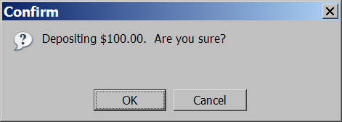
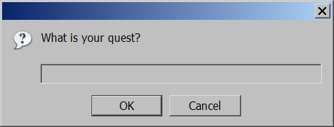
Popup boxes
alert("message"); // message
confirm("message"); // returns true or false
prompt("message"); // returns user input string JS

Slide 34
JavaScript Objects
Real Life Objects, Properties, and Methods
In real life, a student is an object.
Student can have properties name, roll_no.,marks,phone_num, age…
Student can have methods to operate on properties like Calcualte_cgpa(), diplayInfo()….
All student have same properties, values may change
Assume car is an object

Slide 35
let car = "Fiat";
Objects are variables too. But objects can contain many values.
const car = {type:"Fiat", model:"500", color:"white"};
The values are written as name:value pairs (name and value separated by a colon).

Slide 36
<p id="demo"></p>
<script>
// Create an object:
const person = {
firstName: "John",
lastName: "Doe",
age: 50,
eyeColor: "blue"
};
// Display some data from the object:
document.getElementById("demo").innerHTML =
person.firstName + " is " + person.age + " years old.";
</script>

Slide 37
JavaScript Events
HTML events are "things" that happen to HTML elements.
When JavaScript is used in HTML pages, JavaScript can "react" on these events.
HTML Events
An HTML event can be something the browser does, or something a user does.
Here are some examples of HTML events:
An HTML web page has finished loading
An HTML input field was changed
An HTML button was clicked

Slide 38
HTML allows event handler attributes, with JavaScript code, to be added to HTML elements.
<element event='some JavaScript’>
<body>
<button onclick="document.getElementById('demo').innerHTML=Date()">The time is?</button>
<p id="demo"></p>
</body>

Slide 39
<body>
<h2>JavaScript HTML Events</h2>
<button onclick="this.innerHTML=Date()">The time is?</button>
</body>
Try this
<button onclick="displayDate()">The time is?</button>
<script>
function displayDate() {
document.getElementById("demo").innerHTML = Date();
} </script>
<p id="demo"></p>

Slide 40
JavaScript Arrays
Syntax:
const array_name = [item1, item2, ...];
const cars = [ "Saab", "Volvo", "BMW" ];
Accessing Array Elements
const cars = ["Saab", "Volvo", "BMW"]; let car = cars[0]; //Saab

Slide 41
Objects use names to access its "members".
In this example, person.firstName returns John:
<p id="demo"></p>
<script>
const person = {firstName:"John", lastName:"Doe", age:46};
document.getElementById("demo").innerHTML = person.firstName;
</script>

Slide 42
const fruits = ["Banana", "Orange", "Apple", "Mango"]; let length = fruits.length; //4
Looping Array Elements
<p id="demo"></p>
<script>
const fruits = ["Banana", "Orange", "Apple", "Mango"];
let text = "<ul>";
fruits.forEach(myFunction);
text += "</ul>";
document.getElementById("demo").innerHTML = text;
function myFunction(value) {
text += "<li>" + value + "</li>";
} </script>

Slide 43
Adding elements to array
const fruits = ["Banana", "Orange", "Apple"]; fruits.push("Lemon");
OR
const fruits = ["Banana", "Orange", "Apple"]; fruits[fruits.length] = "Lemon";
JavaScript does not support associative arrays.
You should use objects when you want the element names to be strings (text).
You should use arrays when you want the element names to be numbers.

Slide 44
Array methods
var a = ["Stef", "Jason"]; // Stef, Jason
a.push("Brian"); // Stef, Jason, Brian
a.unshift("Kelly"); // Kelly, Stef, Jason, Brian
a.pop(); // Kelly, Stef, Jason
a.shift(); // Stef, Jason
a.sort(); // Jason, Stef
array serves as many data structures: list, queue, stack, ...
methods: concat, join, pop, push, reverse, shift, slice, sort, splice, toString, unshift
push and pop add / remove from back
unshift and shift add / remove from front
shift and pop return the element that is removed

Slide 45
if/else statement (same as Java)
if (condition) {
statements;
} else if (condition) {
statements;
} else {
statements;
}
JS
identical structure to Java's if/else statement
JavaScript allows almost anything as a condition

Slide 46
for loop (same as Java)
var sum = 0;
for (var i = 0; i < 100; i++) {
sum = sum + i;
} JS
var s1 = "hello";
var s2 = "";
for (var i = 0; i < s.length; i++) {
s2 += s1.charAt(i) + s1.charAt(i);
}
// s2 stores "hheelllloo" JS
<script>
const cars = ["BMW", "Volvo", "Saab", "Ford", "Fiat", "Audi"];
let text = "";
for (let i = 0; i < cars.length; i++) {
text += cars[i] + "<br>";
}
document.getElementById("demo").innerHTML = text;
</script> JS

Slide 47
The For In Loop
for (key in object) { // code block to be executed }
const person = {fname:"John", lname:"Doe", age:25}; let text = ""; for (let x in person) { text += person[x]; }
Output for text is John Doe 25

Slide 48
The For Of Loop
for (variable of iterable) { // code block to be executed }
const cars = ["BMW", "Volvo", "Mini"]; let text = ""; for (let x of cars) { text += x; } // BMW Volvo Mini
let language = "JavaScript";
let text = "";
for (let x of language) {
text += x ; } // JavaScript

Slide 49
while loops (same as Java)
while (condition) {
statements;
} JS
do {
statements;
} while (condition); JS
break and continue keywords also behave as in Java

Slide 50
String type
var s = "Connie Client";
var fName = s.substring(0, s.indexOf(" ")); // "Connie"
var len = s.length; // 13
var s2 = 'Melvin Merchant'; JS
methods: charAt, charCodeAt, fromCharCode, indexOf, lastIndexOf, replace, split, substring, toLowerCase, toUpperCase
charAt returns a one-letter String (there is no char type)
length property (not a method as in Java)
Strings can be specified with "" or ''
concatenation with + :
1 + 1 is 2, but "1" + 1 is "11"

Slide 51
JavaScript Callbacks
A callback is a function passed as an argument to another function
This technique allows a function to call another function
A callback function can run after another function has finished
function myDisplayer(some) { document.getElementById("demo").innerHTML = some; } function myCalculator(num1, num2) { let sum = num1 + num2; return sum; //return to result } let result = myCalculator(5, 5); //fncall myDisplayer(result); // fn call

Slide 52
JavaScript Promises
"Producing code" is code that can take some time
"Consuming code" is code that must wait for the result
A Promise is a JavaScript object that links producing code and consuming code
A JavaScript Promise object contains both the producing code and calls to the consuming code:
let myPromise = new Promise(function(myResolve, myReject) {
// "Producing Code" (May take some time)
myResolve(); // when successful
myReject(); // when error
});
// "Consuming Code" (Must wait for a fulfilled Promise)
myPromise.then (
function(value) { /* code if successful */ },
function(error) { /* code if some error */ }
);

Slide 53
A JavaScript Promise object can be:
Pending -- (working), the result is undefined.
Fulfilled -- the result is a value.
Rejected -- the result is an error object.
function myDisplayer(some) { document.getElementById("demo").innerHTML = some; }
[cont..]

Slide 54
let myPromise = new Promise(function(myResolve, myReject) { let x = 0; // The producing code (this may take some time) if (x == 0) { myResolve("OK"); } else { myReject("Error"); } }); myPromise.then( function(value) {myDisplayer(value);}, function(error) {myDisplayer(error);} );
// change x=5 and Try

Slide 55
JavaScript Async
async makes a function return a Promise
await makes a function wait for a Promise
async function myFunction() { return "Hello"; }
Is same as
function myFunction() { return Promise.resolve("Hello"); }

Slide 56
<p id="demo"></p>
<script>
function myDisplayer(some) {
document.getElementById("demo").innerHTML = some;
}
async function myFunction() {return "Hello";}
myFunction().then(
function(value) {myDisplayer(value);},
function(error) {myDisplayer(error);}
);
</script>

Slide 57
The await keyword can only be used inside an async function.
The await keyword makes the function pause the execution and wait for a resolved promise before it continues:
<h1 id="demo"></h1>
<script>
async function myDisplay() {
let myPromise = new Promise(function(resolve, reject) {
resolve(“Welcome!!");
});
document.getElementById("demo").innerHTML = await myPromise;
}
myDisplay();
</script>

Slide 58
Waiting for a Timeout
<h1 id="demo"></h1>
<script>
async function myDisplay() {
let myPromise = new Promise(function(resolve) {
setTimeout(function() {resolve(“Welcome !!");}, 3000);
});
document.getElementById("demo").innerHTML = await myPromise;
}
myDisplay();
</script>

Slide 59


